Slide 1
Model-Driven Engineering Support
Supervised By: Juergen Dingel
Laith “Leo” Juwaidah, Nondini Das, Suchita Ganesan

Slide 2
Outline
Introduction to Model Driven Engineering
Model Driven Engineering with Papyrus-RT
Research Project Goals
Approach
Current Progress
Next Steps

Slide 3
Introduction to MDE

Slide 4
Traditional Software Development Process

Slide 5
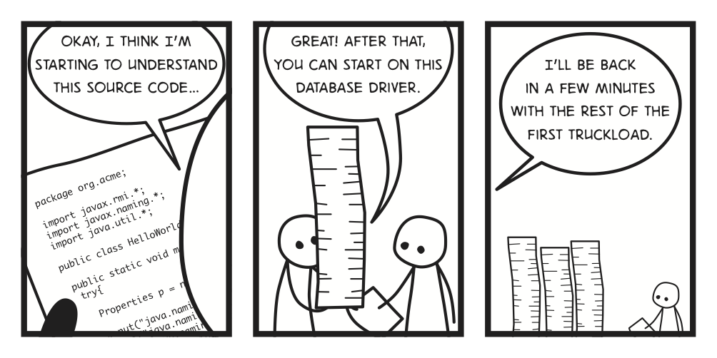
Motivation
Software ranks the most complex human made artifacts.
Increasing Complexity of Software

Slide 6
Consequence of Complexity

Slide 7
What are Models?
Models provide a blueprint of the code
UML is enormously convenient for communicating design concepts.
UML is a graphical notation for drawing diagrams of software concepts.
They promote abstraction and easy to understand.
Enhances Clarity.

Slide 8
Model Driven Engineering ( MDE)
Software Development Methodology focuses on the creation of domain models which are conceptual models of all topics related to a specific problem.

Slide 9
MDE
Improve productivity, quality and ability to handle complexity by:
Increasing level of Abstraction
Through use of Models E.g., UML Diagrams
Leveraging Automation
E.g., via code generation from models
Improving Analysis Capabilities
E.g., through executable models
MDE = Abstraction + Automation + Analysis

Slide 10
Potential Benefits of MDE approach
Faster
Cost – effective
Leads to Increased Quality
Less Error Prone
MDE leads to meaningful validation
MDE provides up-to-date documentation

Slide 11
Challenge of MDE
Technical Issues
Incremental Code Generation
Model Transformation
Cultural Issue
Adoption of MDE approach
Syntax & Semantics

Slide 12
State of the Art
Companies using MDE approach
Ericsson - tele communication systems
General Motors
Proprietary:
IBM Rational Rose Family
Rational Rhapsody Developer
Open Source:
Mentor Graphics Bridgepoint
Papyrus-RT (in the near future)

Slide 13
MDE with Papyrus-RT

Slide 14
Papyrus-RT
Open source Eclipse plugin.
Real-time.
Notes:
UML to UML-RT

Slide 15
Class Diagrams

Slide 16
Structure Diagrams
Notes:
Structure

Slide 17
Statemachine Diagrams
Notes:
Behaviour

Slide 18
Generated Code

Slide 19
Running Application

Slide 20
Research Project Goals

Slide 21
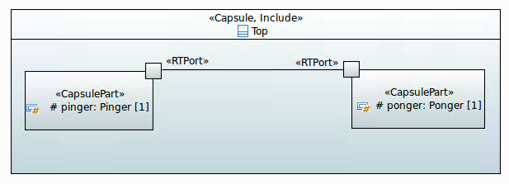
Problem Statement
UML MARTE profile allows the integration of timing and resource information in the model
Determining the correctness of a lot of this information on the model-level is impossible
Models of external components interacting with a component to be developed can be very useful; however, creating these models can be tedious and error-prone

Slide 22
Solution
To use run-time monitoring of generated code to automatically validate, correct, or extract:
Timing and resource information in the model
Models of external components

Slide 23
What we want to achieve
UML-RT
model in Papyrus
Updated UML-RT
model in Papyrus
Add specification of run-time information to be collected
M
M’
M
M’
Analyze the trace and make necessary changes in the model
Code-generation feature of Papyrus
Linux Trace Toolkit: next generation (LTTng)
Automatically Generated source code
Linux Trace Toolkit: next generation (LTTng)
Automatically Generated source code
Input the source code to LTTng

Slide 24
What we want to achieve
UML-RT
model in Papyrus
Updated UML-RT
model in Papyrus
Add specification of run-time information to be collected
M
M’
Analyze the trace and make necessary changes in the model
Code-generation feature of Papyrus
Linux Trace Toolkit: next generation (LTTng)
Automatically Generated source code
Input the source code to LTTng

Slide 25
Approach
Code Generation (Laith “Leo” Juwaidah)
Monitoring Using LTTng (Nondini Das)
Display & Use of Results (Suchita Ganesan)

Slide 26
Code Generation
Allow input and specification of runtime information.
Modifythe code generator to produce LTTng-ready code.

Slide 27
Monitoring using LTTng
Monitor generated code
Collect the runtime information in appropriate way
View trace file

Slide 28
Display and Use of Results
Displaying Results:
When combined with automatic code generation, there is a risk of unintended behavior
Once the application with the LTTng instructions is ran, LTTng stores the results in a file
To help developers stay away from the code, the results need to be displayed on the model
Tracing Usefulness:
Information primarily useful for programmers for debugging purposes
E.g., Latency Checks
Used both in developmental phase and after software is released
Models are easier to understand

Slide 29
Current Progress

Slide 30
Code Generation
Setup two separate development environments.
Generate PingPong code.
Compile generated code.

Slide 31
Tracing of a Simple Program

Slide 32
Next Steps

Slide 33
Next Steps
Code Generation
Start small
Modifying code generation
Monitoring using LTTng
Monitoring generated code from model
Writing and placing tracepoints according to user input
Monitoring more complex information
Data Display
Understand the Output
Display the output on the Model

Slide 34
Questions?

